Slide 1

PROJECT BASED LEARNING ON R
ANALYSING FOOD DELIVERY
DATA USING R
NAME:S.LAHARIKA
ROLL NO:23EG110C55
COURSE:B.TECH(CSE-DS)

Slide 2
INTRODUCTION
Online food delivery platforms generate large amounts of operational and customer data.
• This data includes delivery time, customer ratings, traffic conditions, and delivery performance.
• Analyzing this data helps improve delivery efficiency and reduce delays.
• It also helps improve customer satisfaction and service quality.
• In this project, food delivery data was analyzed using R programming.
• Visualization techniques were used to identify patterns and factors affecting delivery performance.

Slide 3
OBJECTIVES
• To analyze food delivery data using R programming
• To study delivery time distribution
• To evaluate customer ratings
• To analyze the impact of traffic density
• To compare performance across cities and age groups
80% of consumers now expect same-day delivery options.

Slide 4
DATASET DESCRIPTION
The dataset contains 37,231 delivery records. It includes delivery time, delivery person age, ratings, traffic density, weather conditions, city type, and multiple deliveries. This data helps evaluate delivery performance and operational efficiency.

Slide 5
TOOLS USED
• RStudio
• ggplot2 (Visualization)
• dplyr (Data Manipulation)

Slide 6
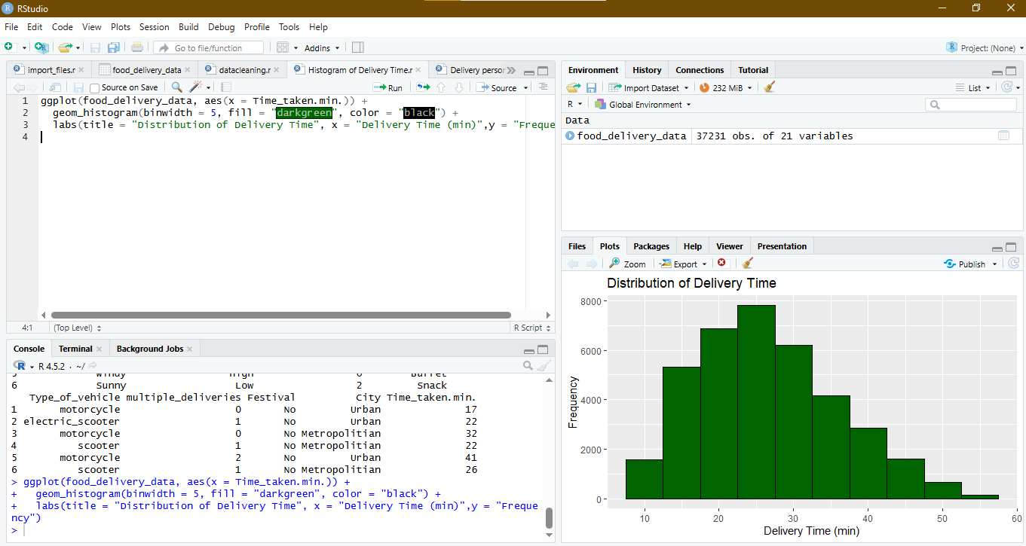
Delivery Time Distribution

Slide 7
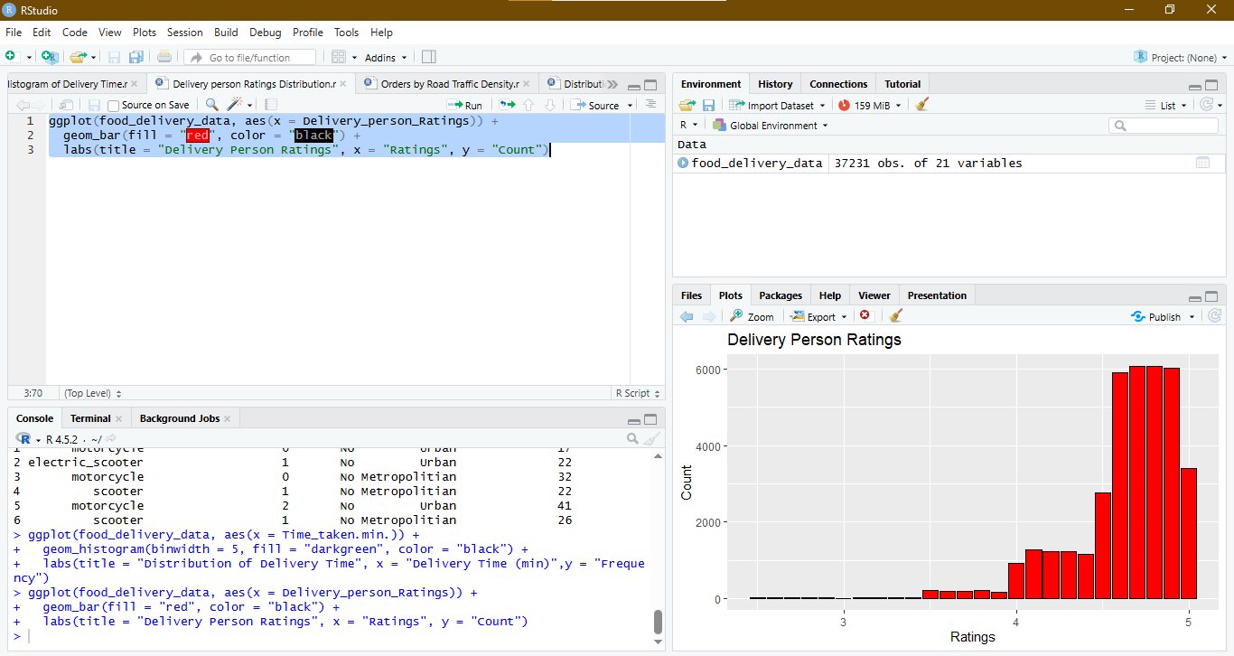
Delivery Person Ratings Distribution

Slide 8
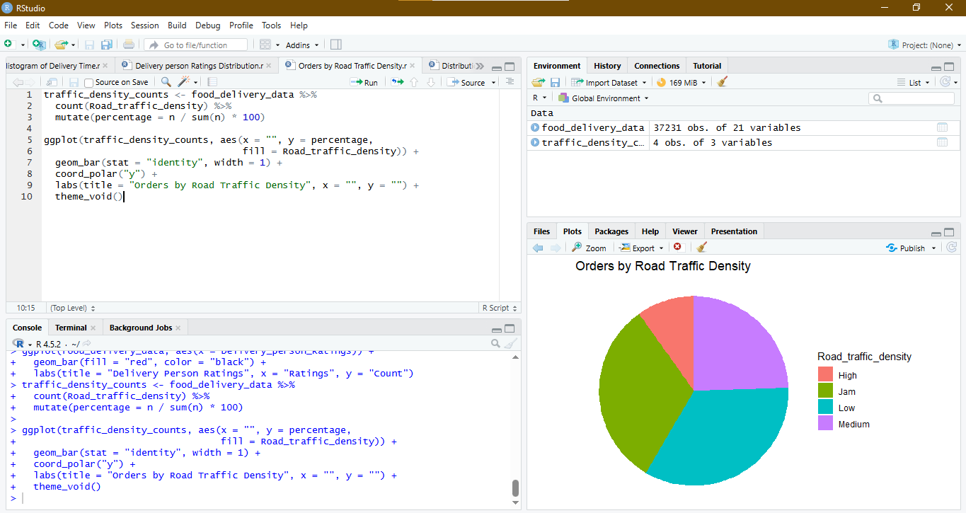
Orders by Road Traffic Density

Slide 9
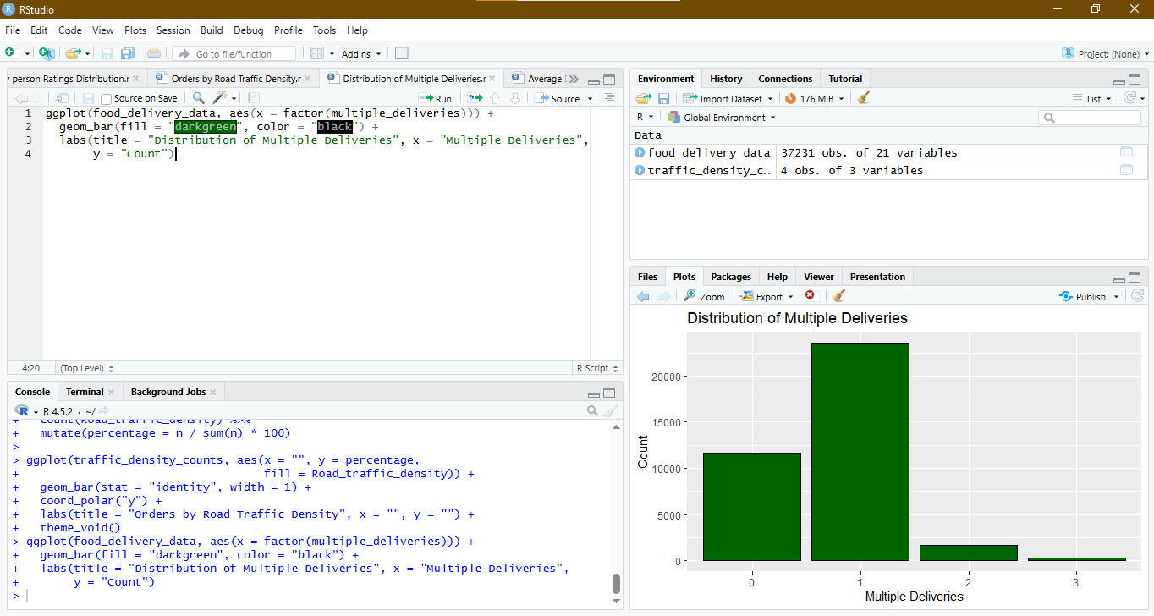
Multiple Deliveries Distribution

Slide 10
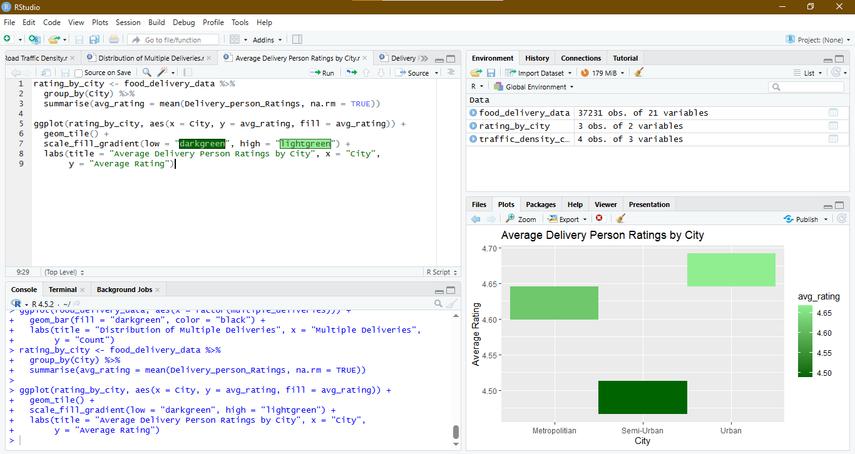
Average Ratings by City

Slide 11
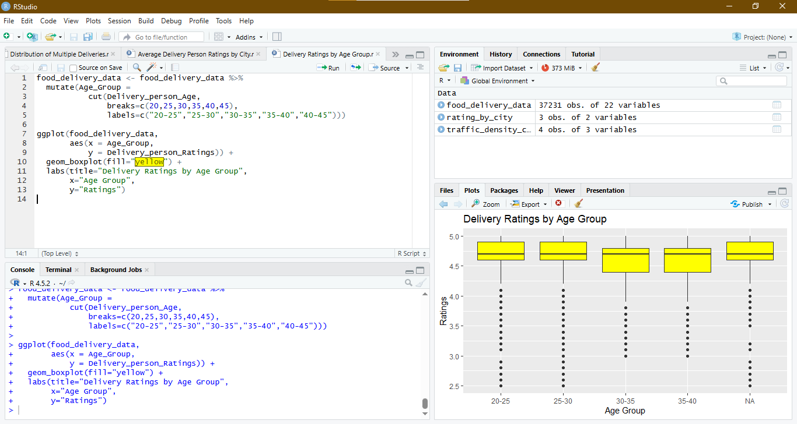
Ratings by Age Group

Slide 12

CONCLUSION
• Most deliveries are completed within 20–35 minutes
• Customer ratings are generally high (above 4.5)
• Traffic density significantly affects delivery time
• Urban areas show slightly better performance
• Delivery performance is consistent across age groups
Overall, the analysis shows that the delivery system is efficient and maintains high customer satisfaction.
R programming proved to be an effective tool for real-world data analysis.

